Slide 1


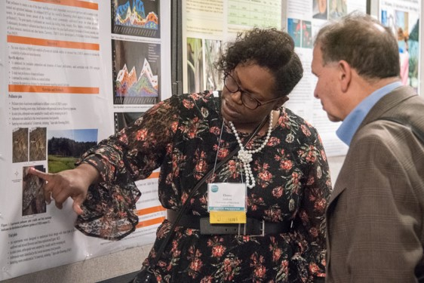
February 28 - March 3, 2022 - Denver, CO
Network with over 600 attendees in pest management fields! Symposium sessions will address Integrated Pest Management (IPM) across disciplines, internationally and in the marketplace.
Learn more at ipmsymposium.org.

